Slide 1
ORACLES forecasting Briefing Meteorology
Briefing on 06-09-2016 8am
Forecasting for flight 7/10-09-2016

Slide 2
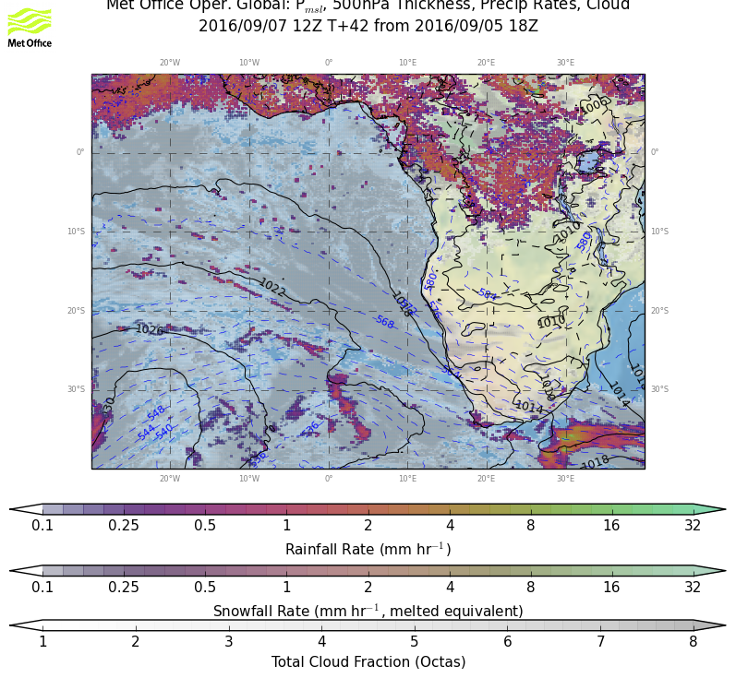
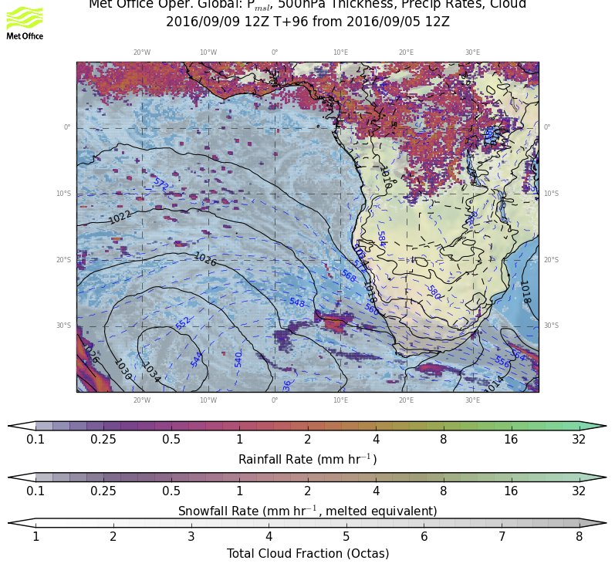
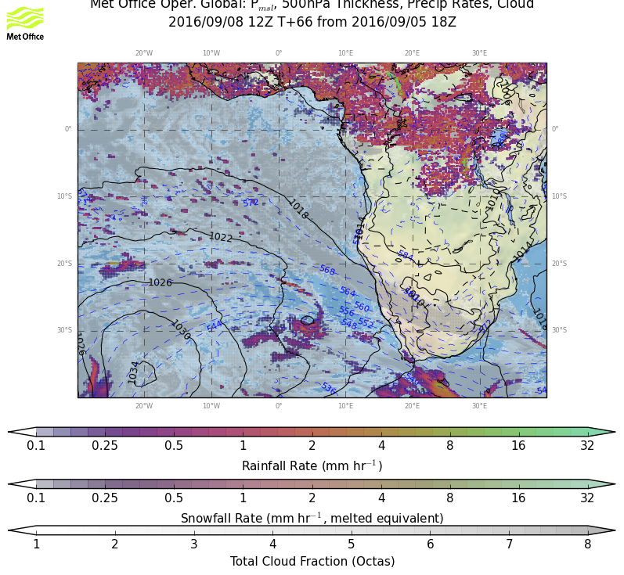
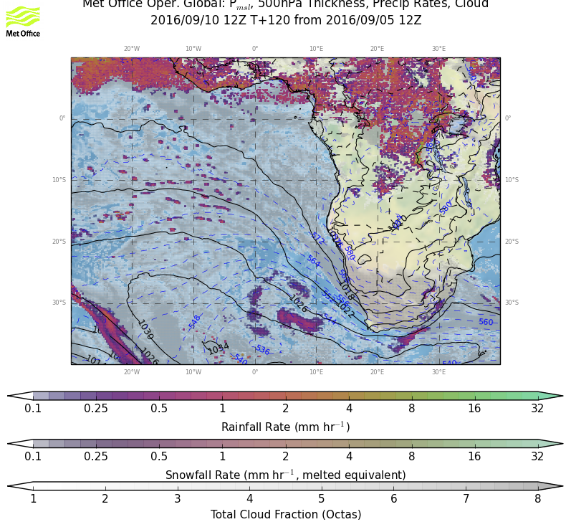
9/7 WED, 12Z
Weather overview:
P msl
Cloud cover
Precip
9/9 FRI, 12Z
9/8 THU, 12Z
9/10 SAT, 12Z
RF
OF

Slide 3
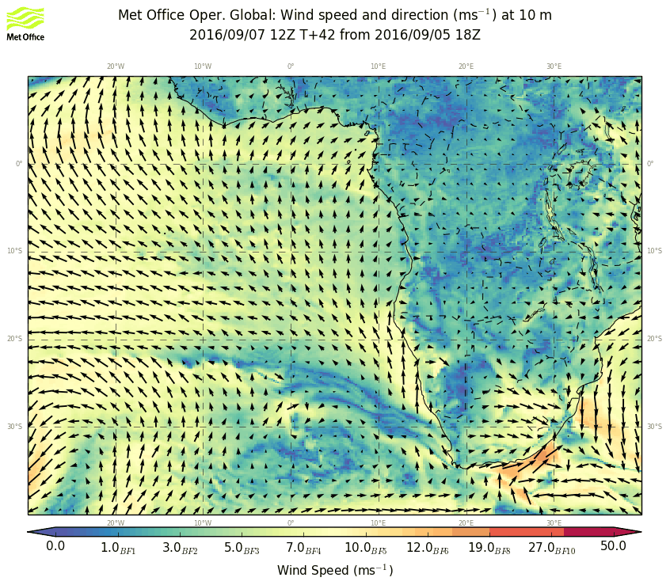
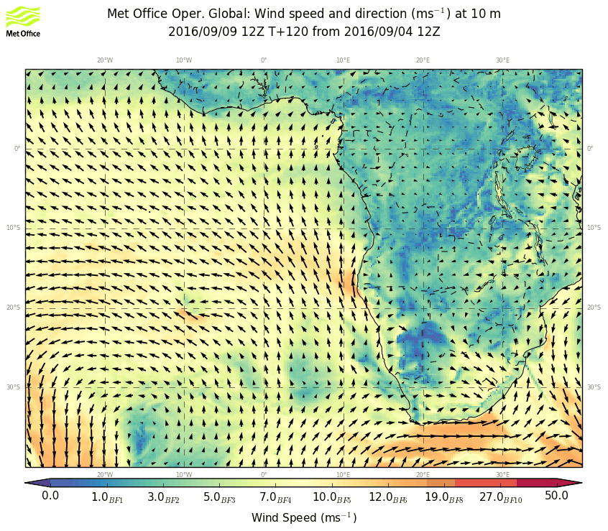
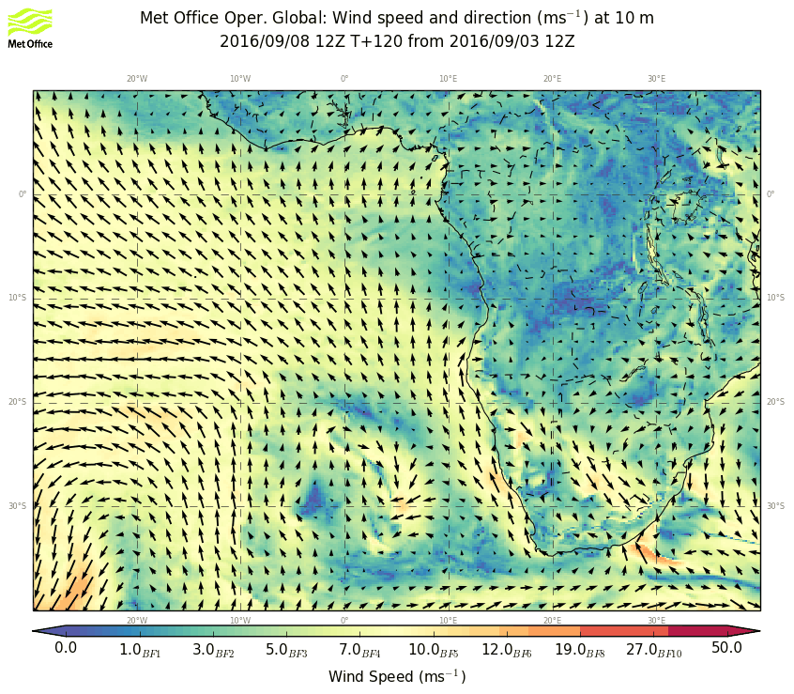
9/7 WED, 12Z
9/9 FRI, 12Z
WIND 10 m
9/8 THU, 12Z
9/10 SAT, 12Z
RF
OF

Slide 4
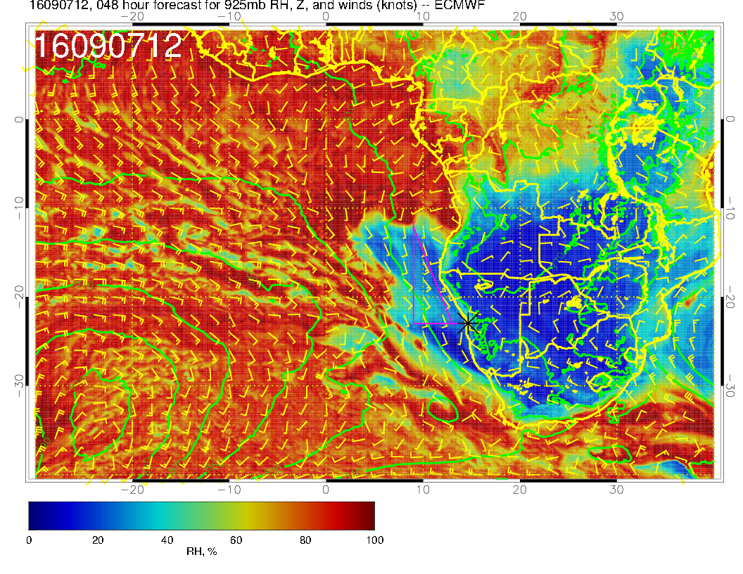
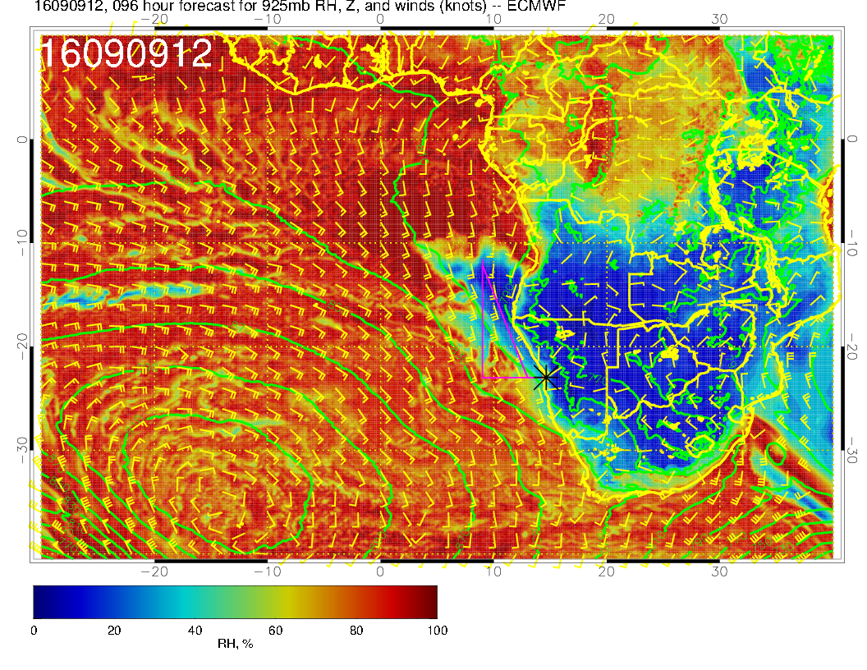
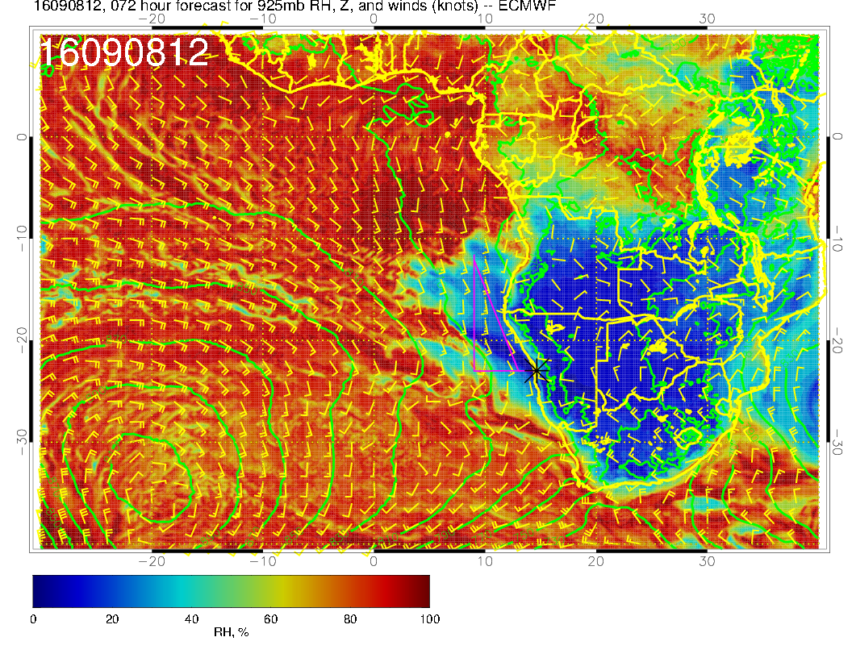
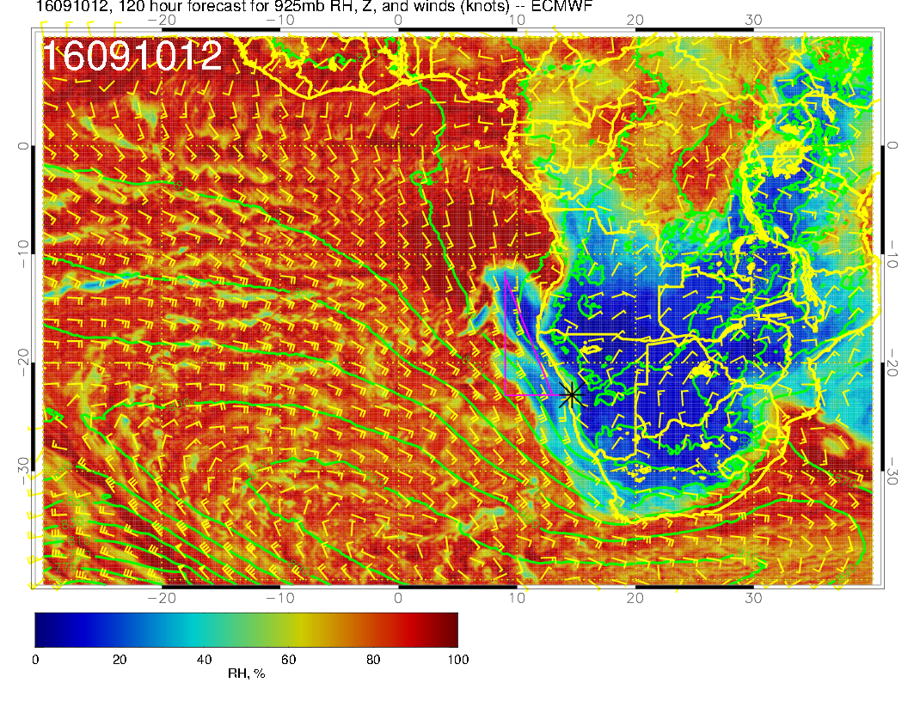
9/7 WED, 12Z
9/9 FRI, 12Z
WIND & RH 925 hPa
9/8 THU, 12Z
9/10 SAT, 12Z
RF
OF

Slide 5
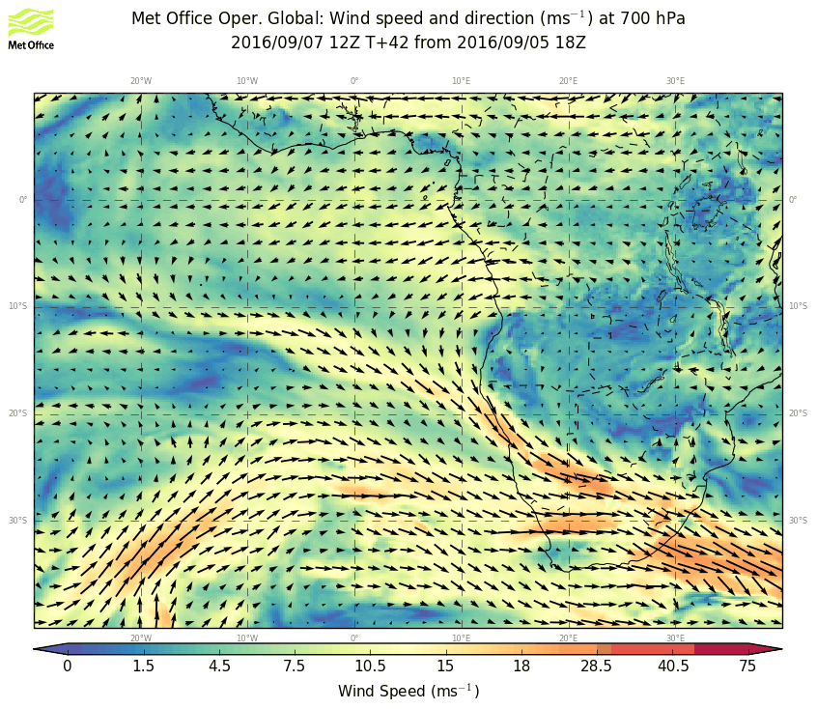
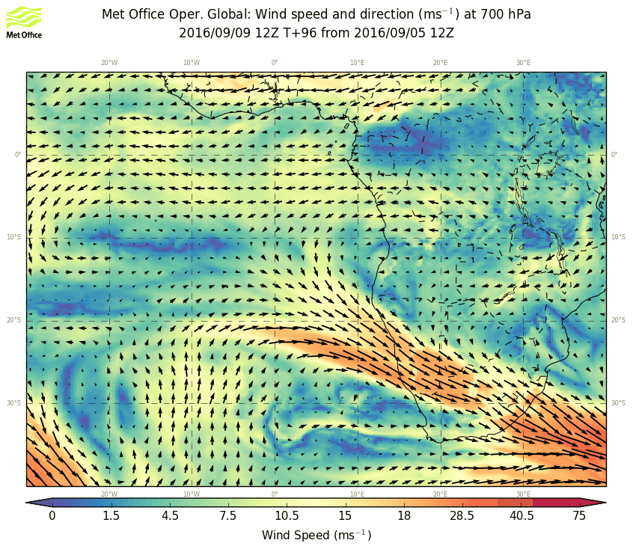
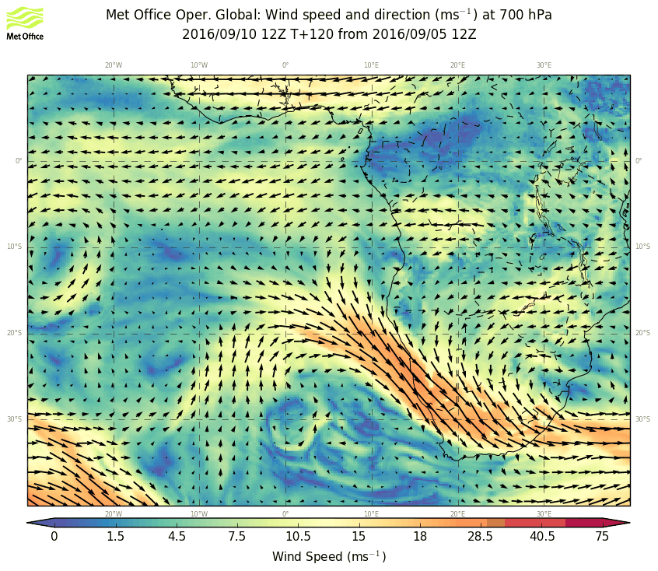
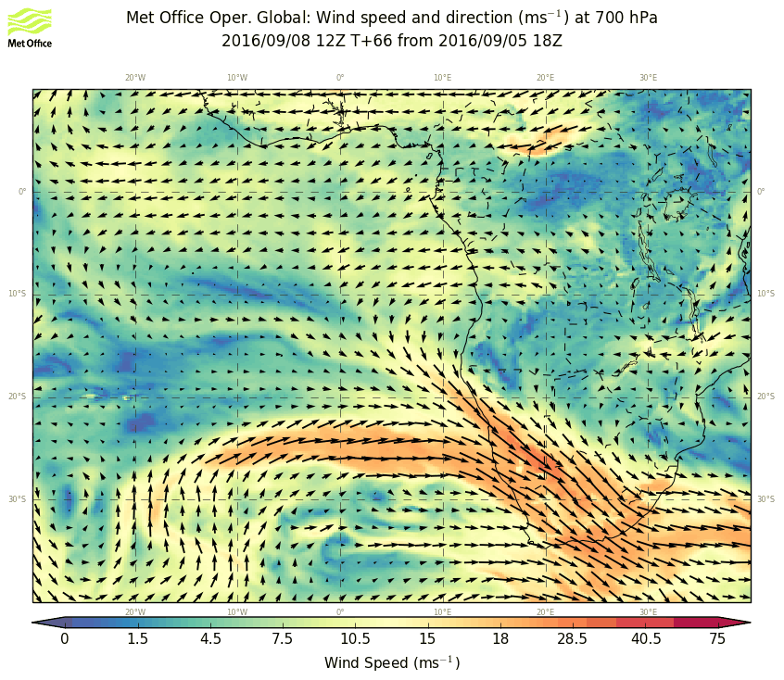
9/7 WED, 12Z
9/9 FRI, 12Z
WIND 700 hPa
9/10 SAT, 12Z
9/8 THU, 12Z
RF
OF

Slide 6
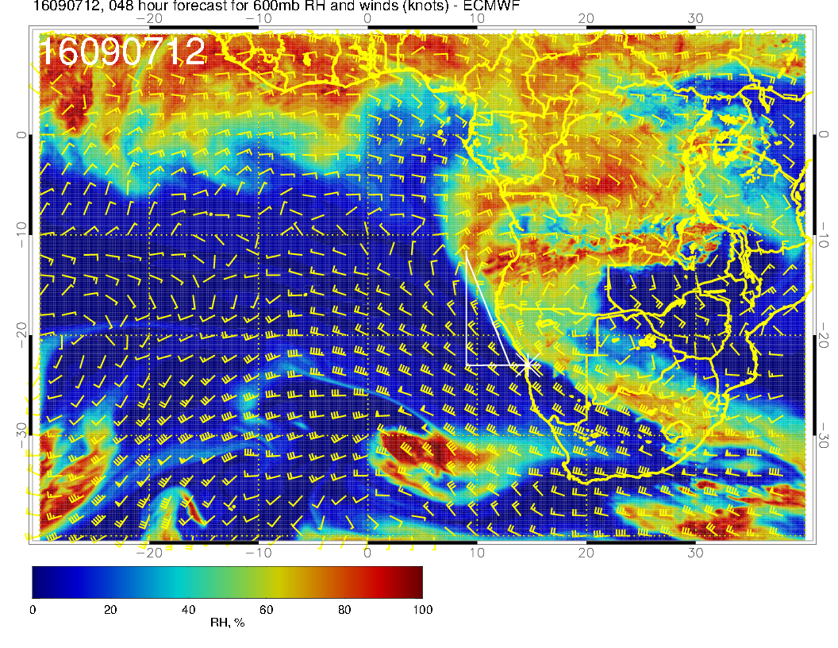
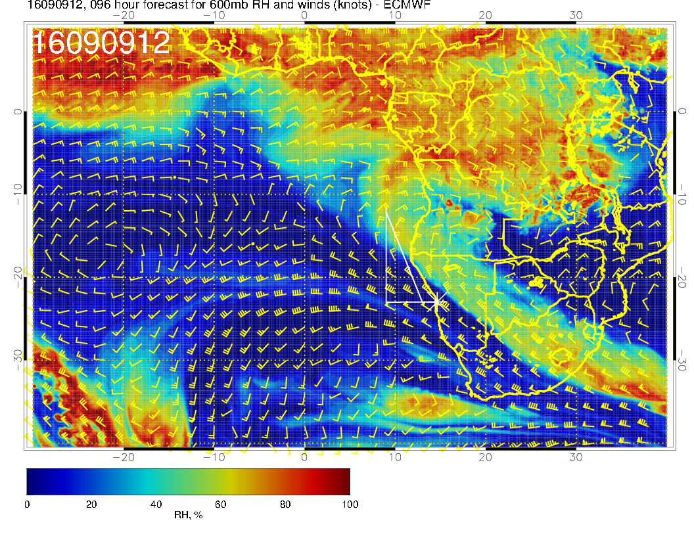
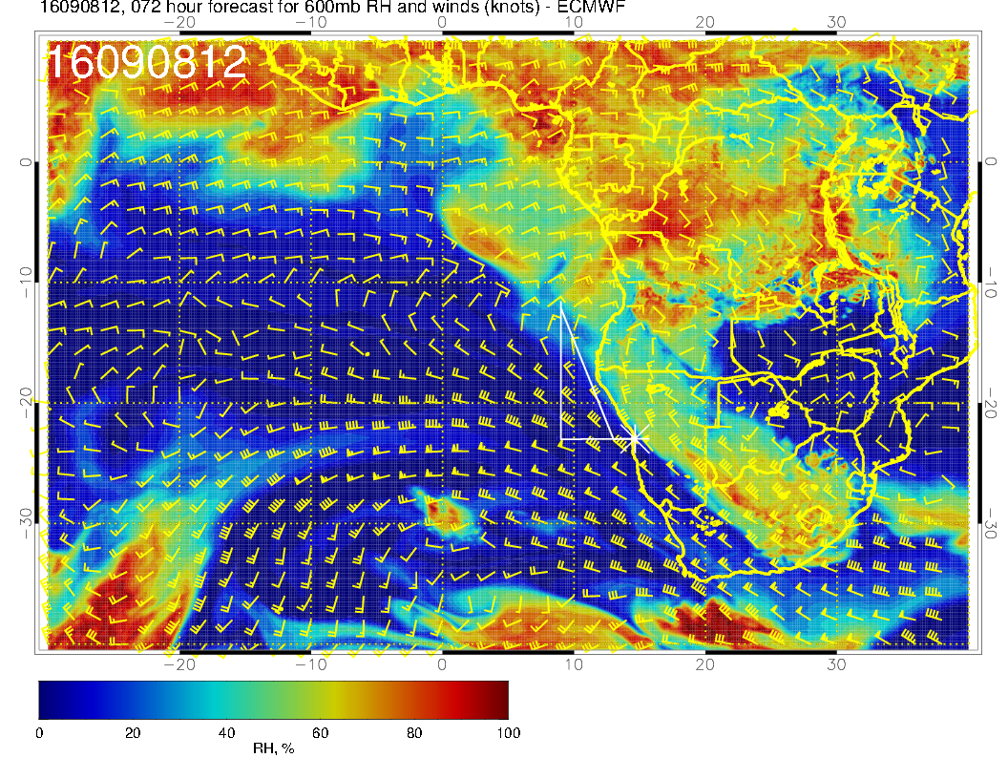
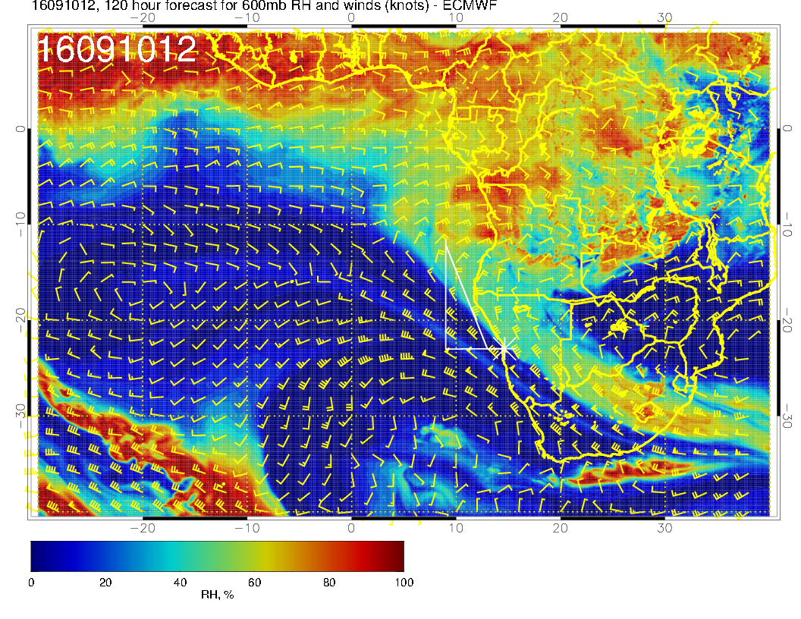
9/7 WED, 12Z
9/9 FRI, 12Z
WIND 600 hPa
9/10 SAT, 12Z
9/8 THU, 12Z
RF
OF

Slide 7
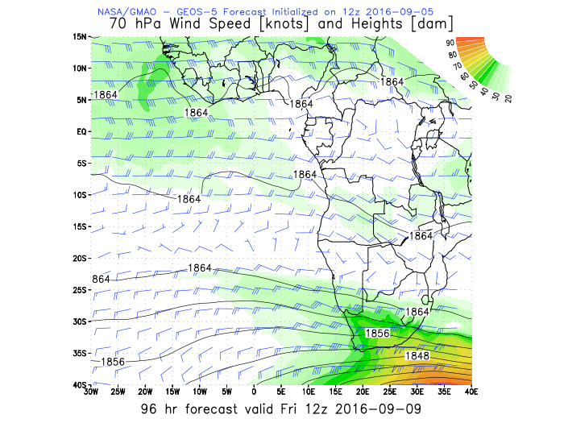
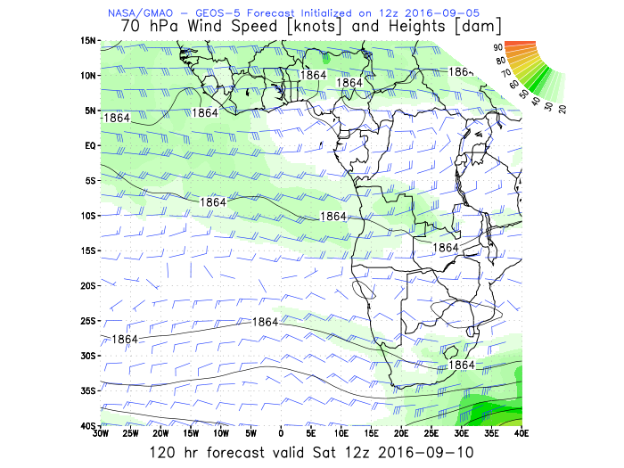
WIND 70 hPa
ER-2 alt
9/9 FRI, 12Z
9/10 SAT, 12Z
OF

Slide 8
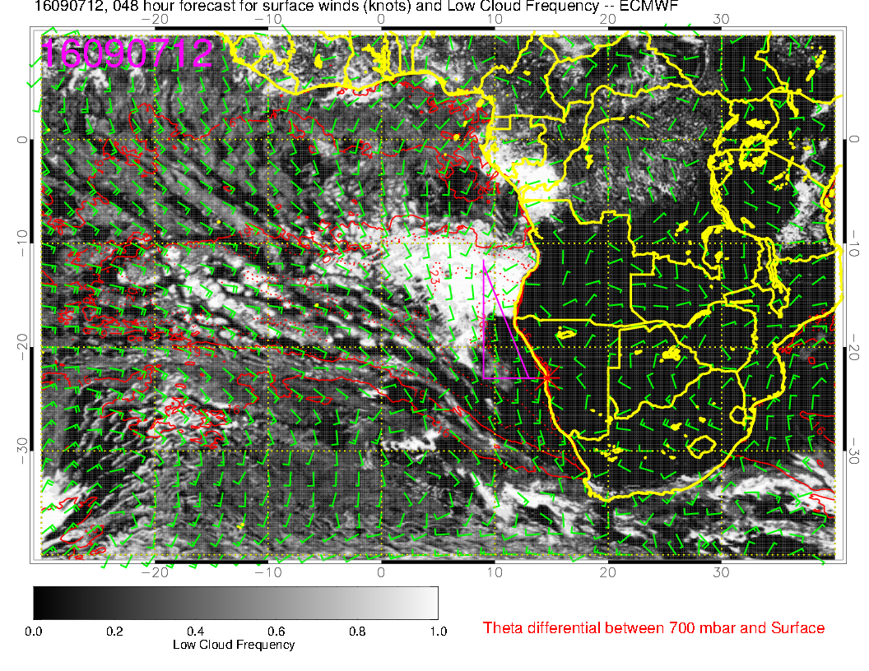
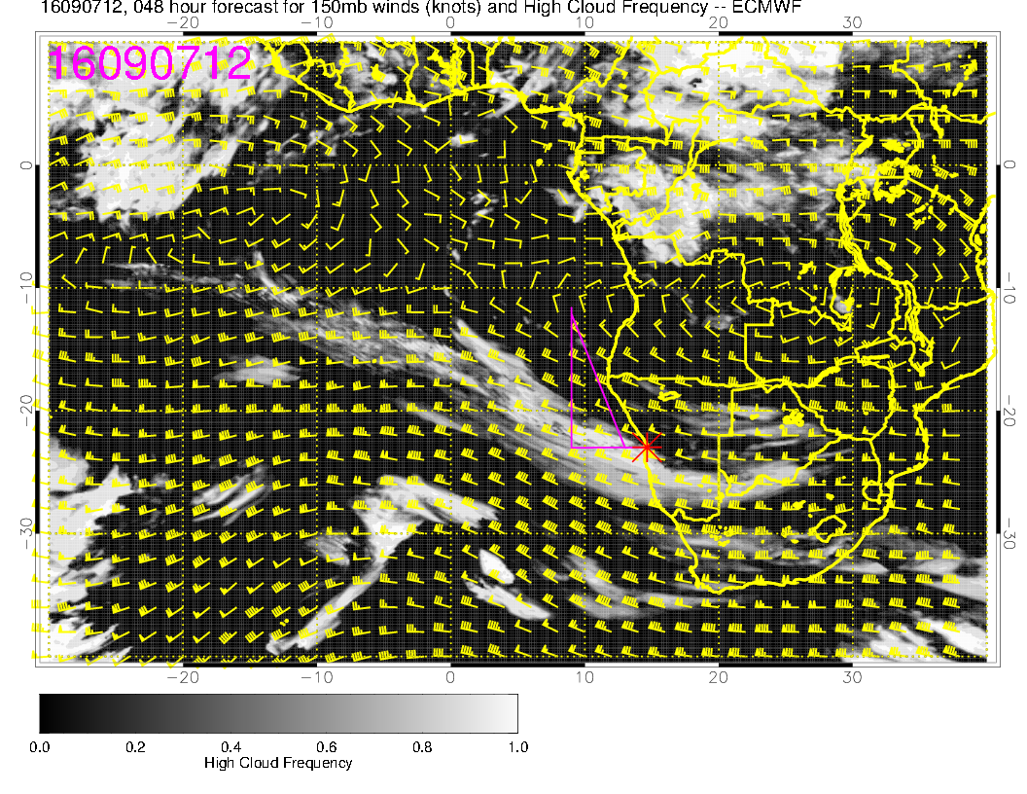
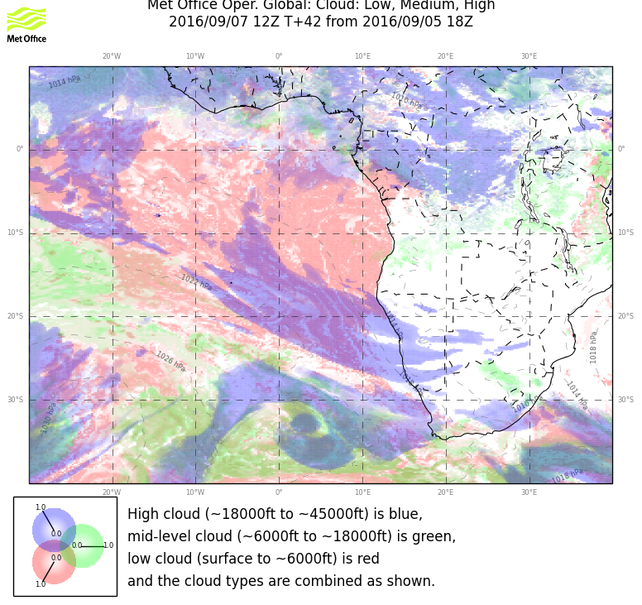
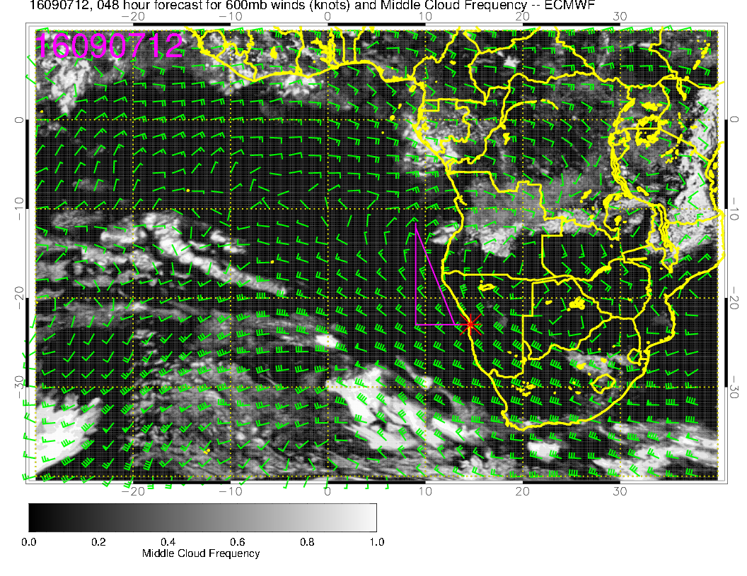
low
9/7 WED, 12Z
high
mid

Slide 9
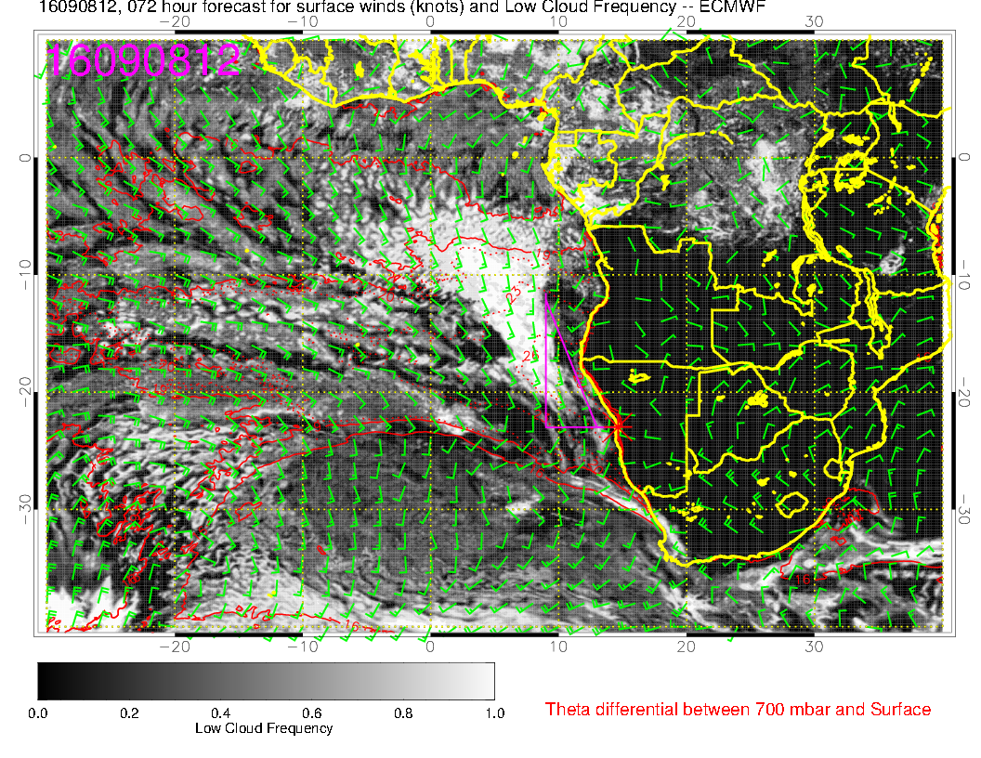
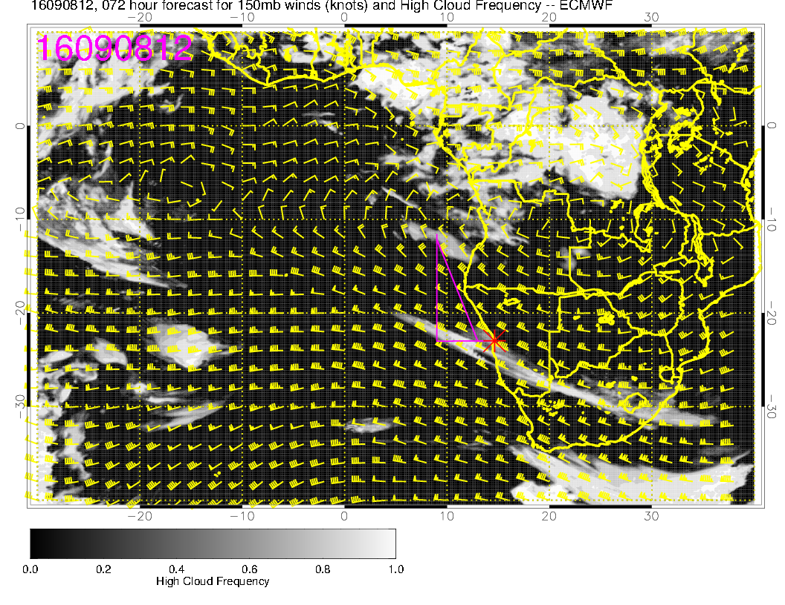
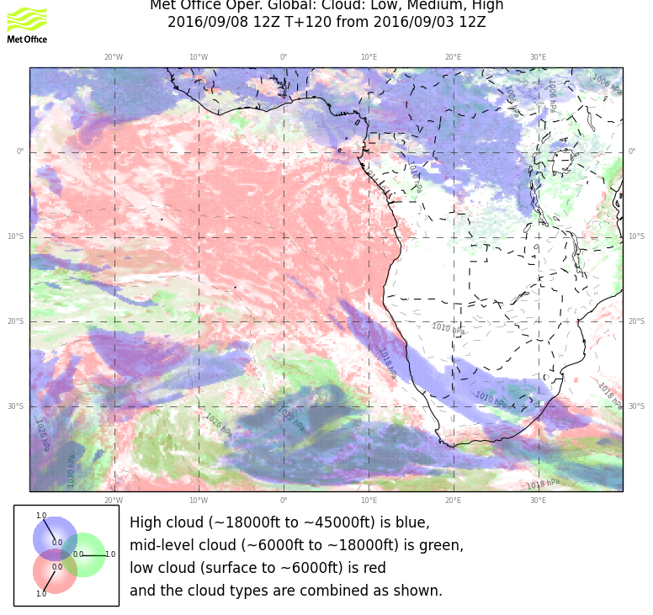
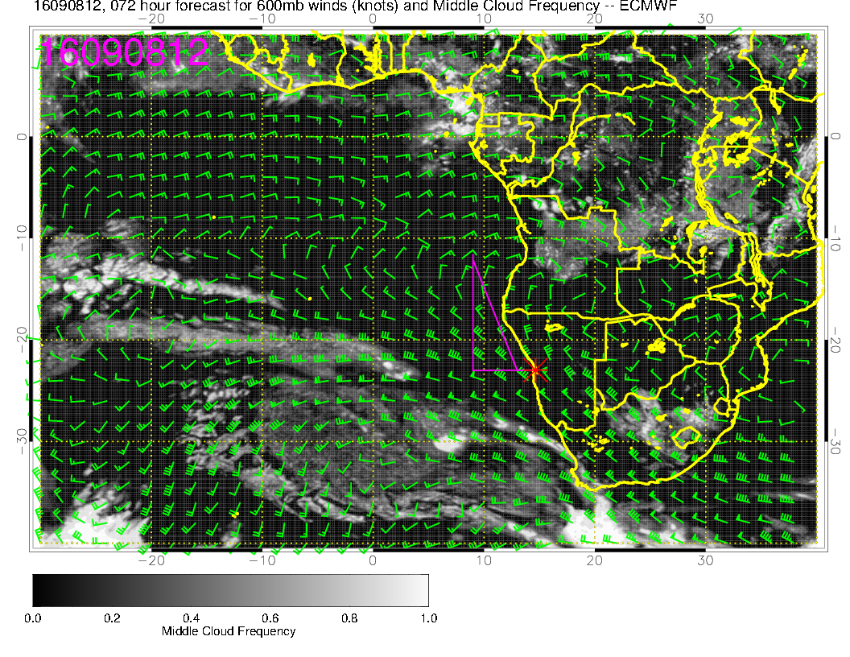
9/8 THU, 12Z
low
high
RF
mid

Slide 10
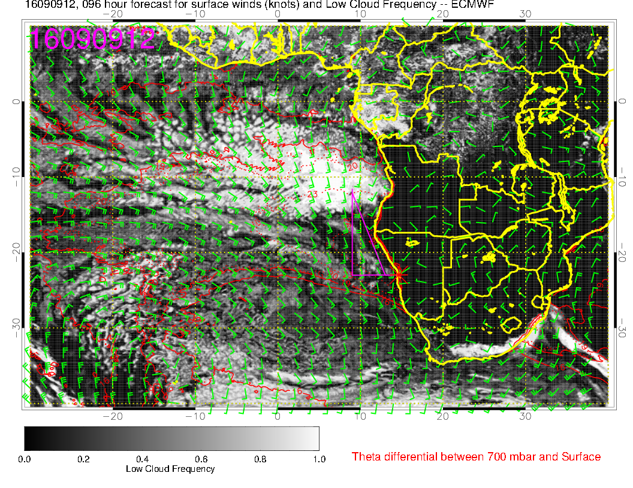
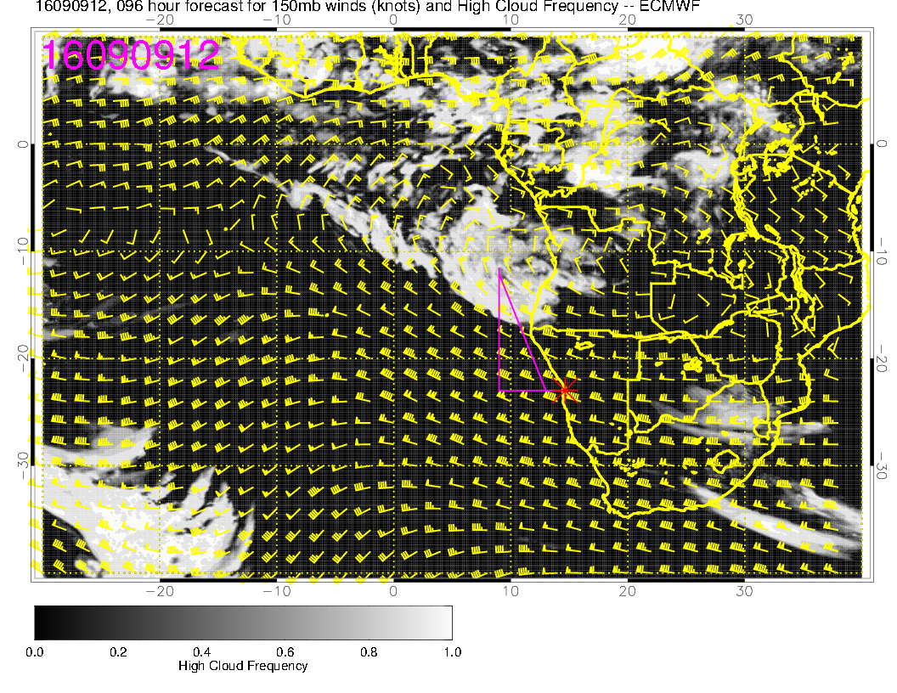
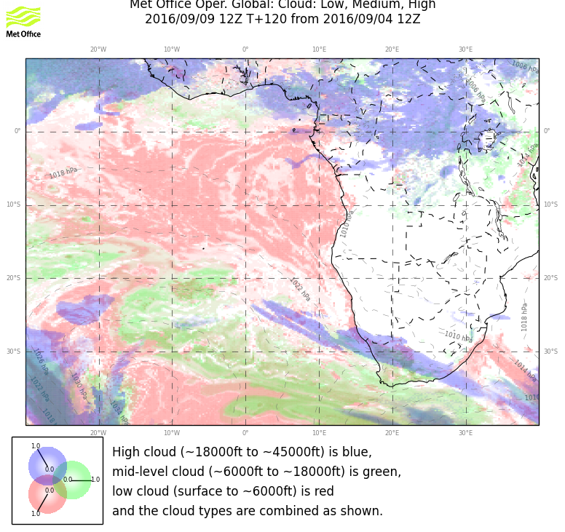
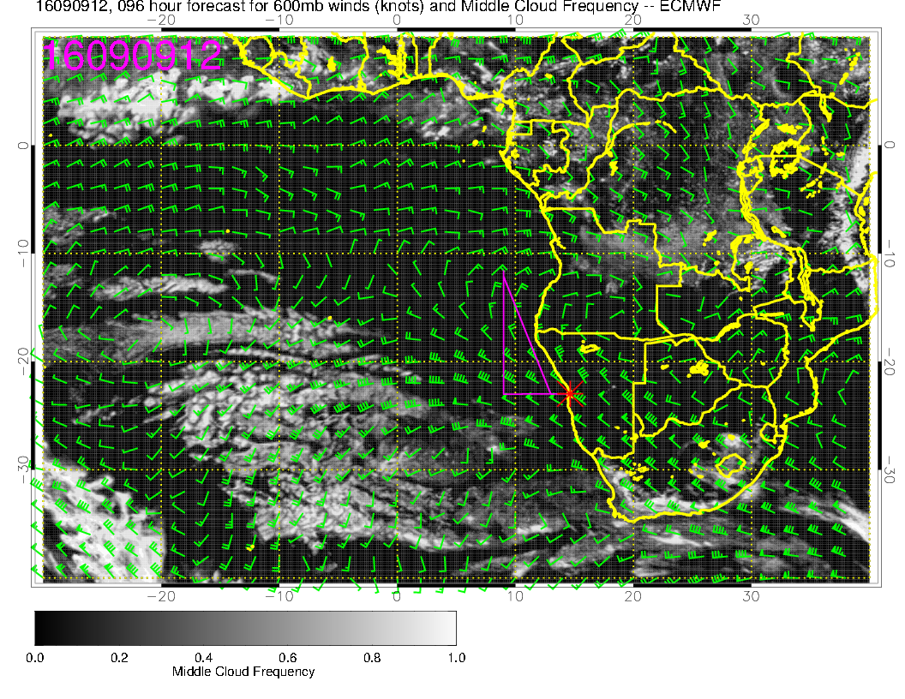
9/9 FRI, 12Z
low
high
mid

Slide 11
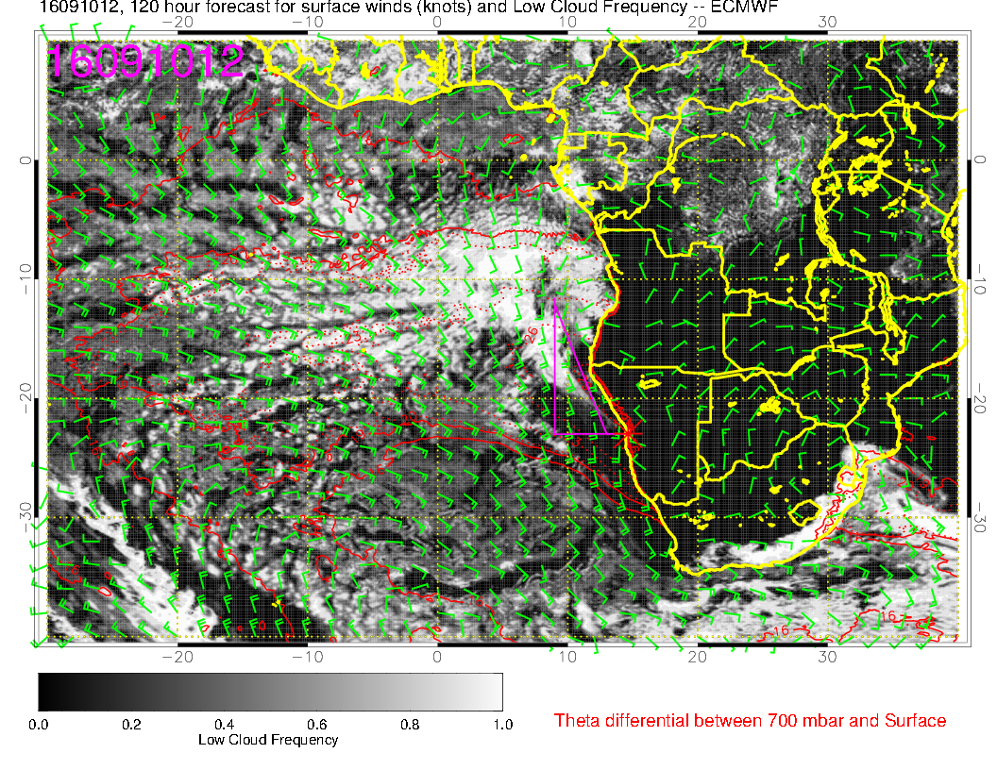
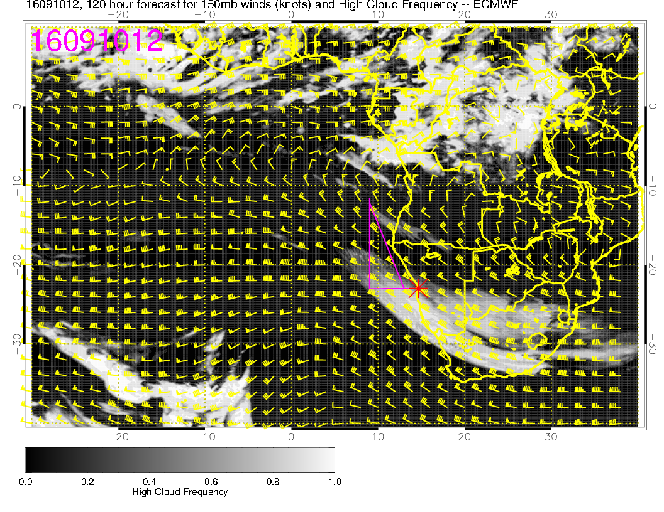
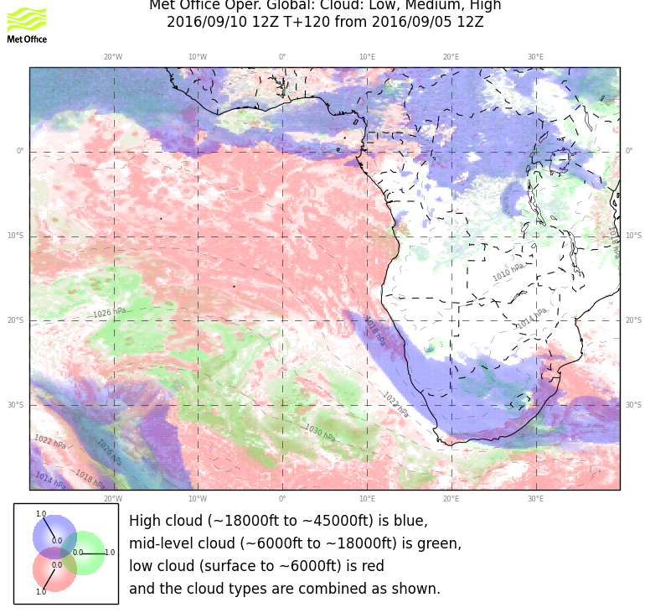
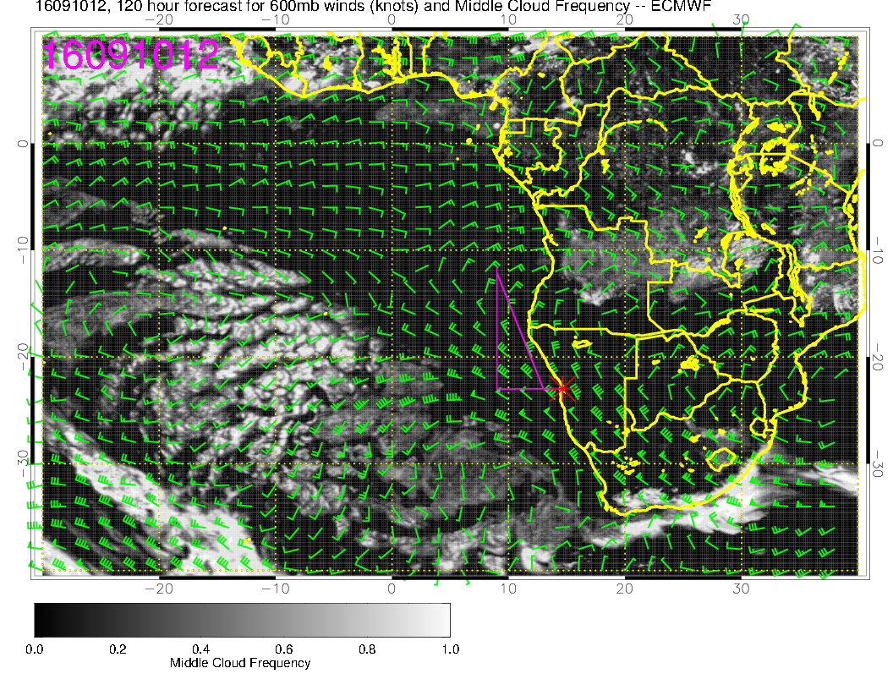
low
9/10 SAT, 12Z
high
TOF
mid

Slide 12
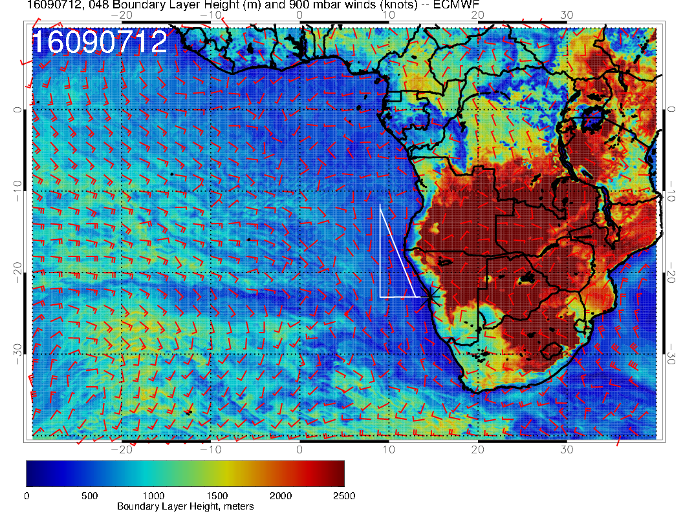
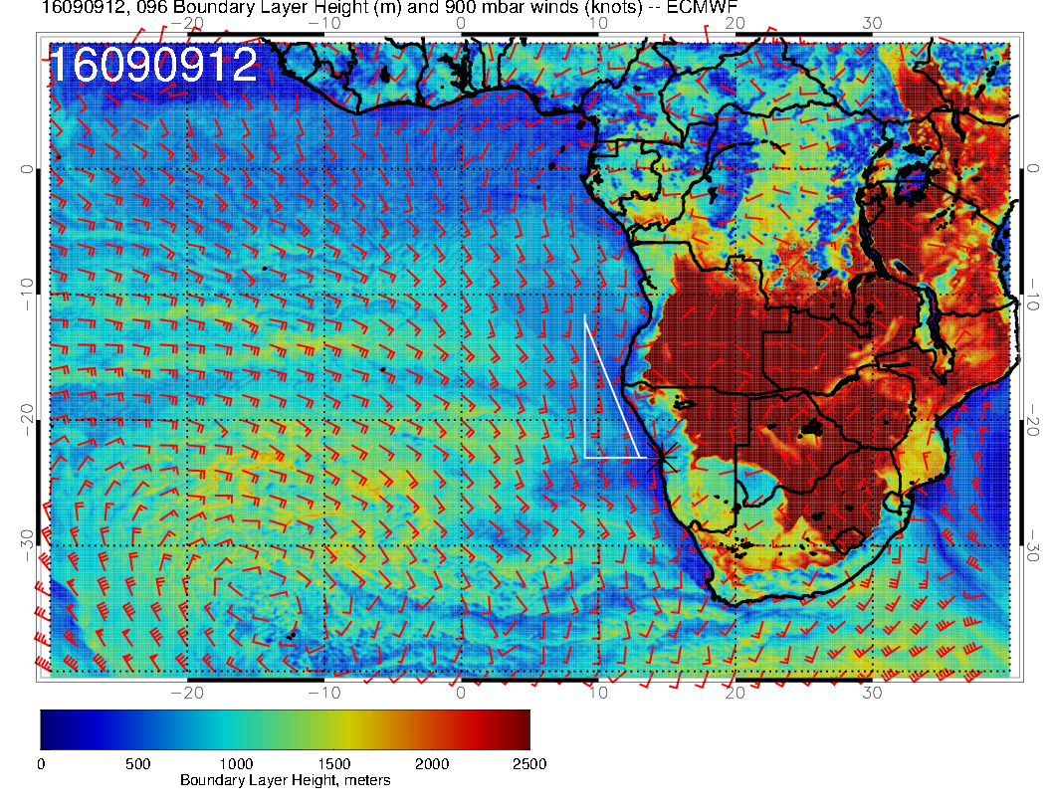
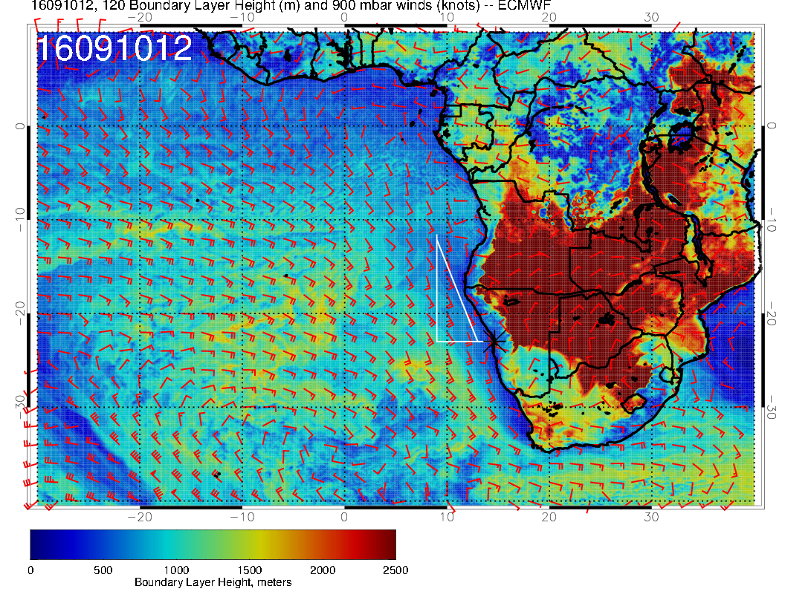
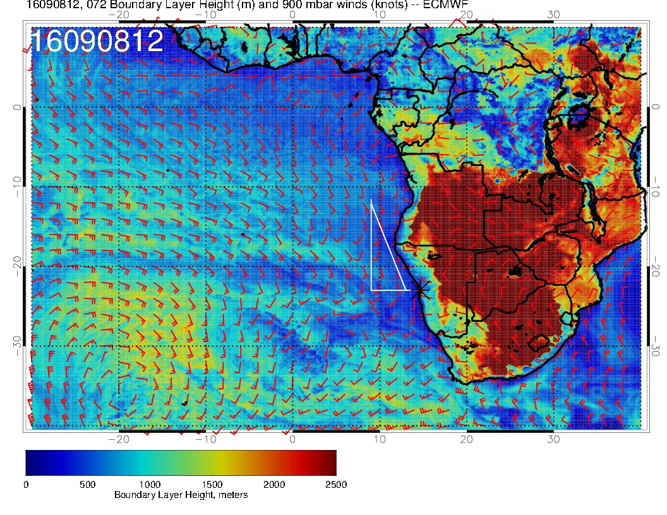
9/9 FRI, 12Z
9/7 WED, 12Z
Boundary Layer Height
9/10 SAT, 12Z
9/8 THU, 12Z
OF
RF

Slide 13
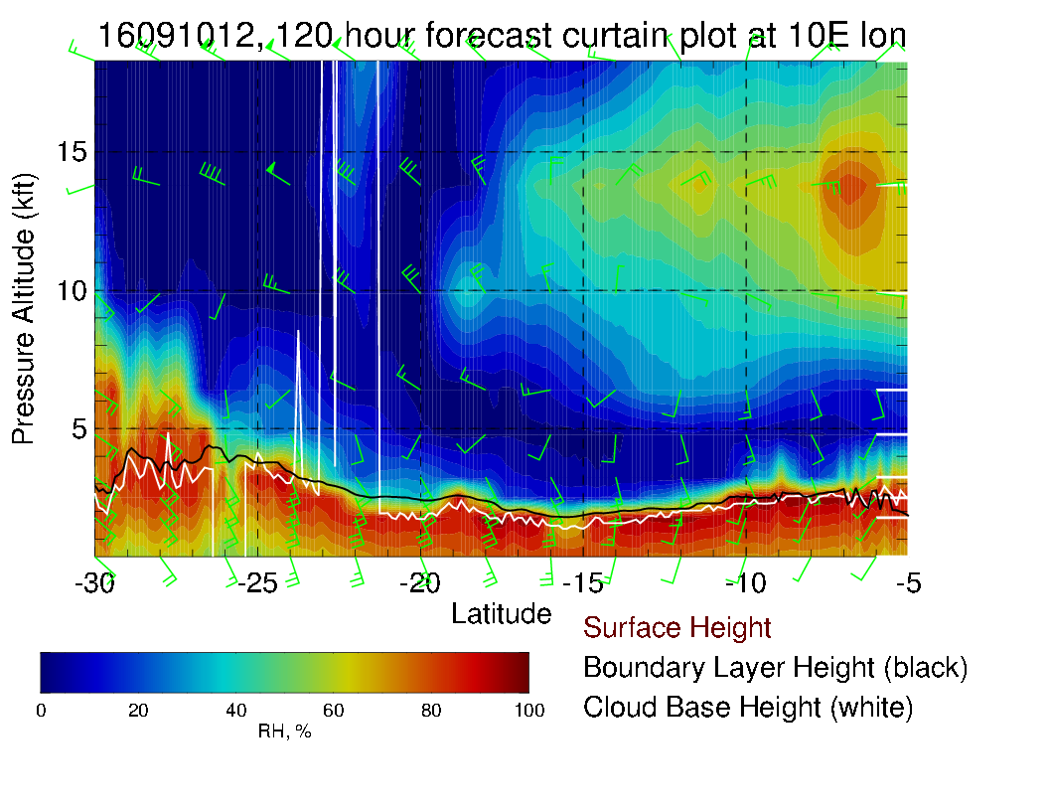
9/8 THU, 12Z
9/10 SAT, 12Z
RF
OF

Slide 14
Summary Thursday Routine Flight
Cirrus over the first part of the routine flight track (narrow line, could be also just south of the track), but overall low high cloud cover
No mid level clouds
Sc deck is separated into a closed and open cloud field along the line of the RF

Slide 15
Summary Saturday Target Opt Flight, ER-2?
120 hour forecast – but the two models agree pretty well
Broad patch of Cirrus over our region, but clear over the Sc field
No mid level clouds
Low cloud decks starts to be more consistent north of -20S (cold front)
PBL and Cloud base higher than on the other days, 1000 – 1500 m
70 hPa seem OK to fly the ER-2, maximum winds below 30 knots (~25 knots)

